Slide 1
Voting Methods
A presentation
by
Merin Jose
Kashyap Uppuluri
Shruti Vangari

Slide 2

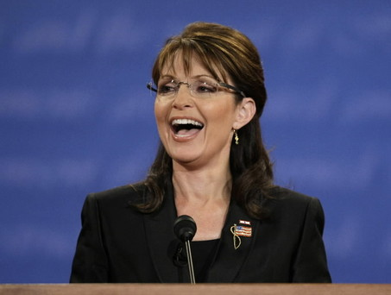
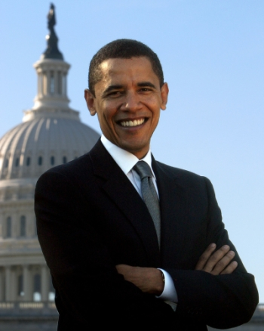
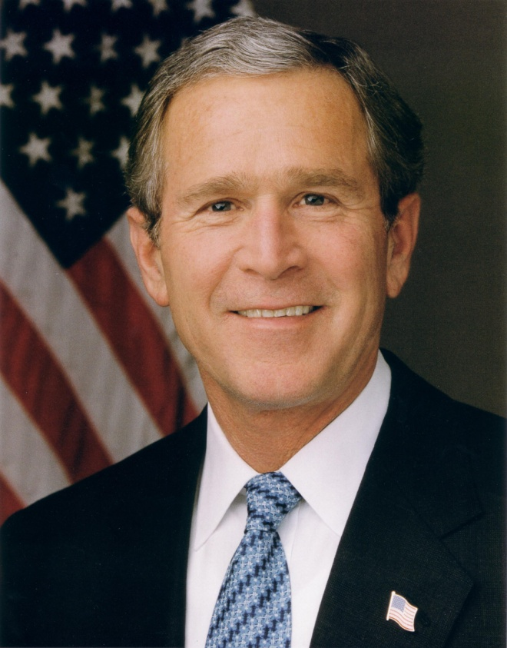
Why Voting Methods?

Slide 3
Election statistics!
P1 | P2 | P3 | P4 | P5 | P6
Obama | Obama | Palin | Palin | Bush | Bush
Bush | Palin | Bush | Obama | Obama | Palin
Palin | Bush | Obama | Bush | Palin | Obama
9 | 5 | 4 | 5 | 4 | 3

Slide 4
Who is the winner? – Method I
A >_{M} B just in case n₁+n₂+n₅ > n₃+n₄+n₆ (otherwise B ≥_{M} A)
A >_{M} C just in case n₁+n₂+n₃ > n₄+n₅+n₆ (otherwise C ≥_{M} A)
B >_{M} C just in case n₁+n₃+n₄ > n₂+n₅+n₆ (otherwise B ≥_{M} C)

Slide 5
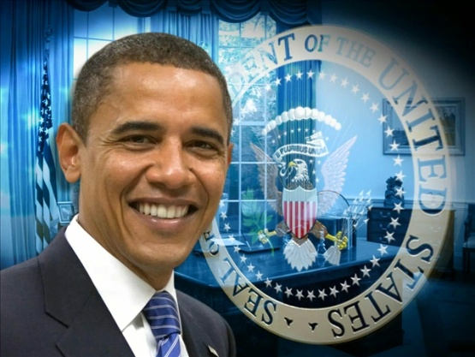
Method I = Condorcet Winner
19 rank Obama above Bush
18 rank Obama above Palin
11 rank Bush above Obama
16 rank Bush above Palin
12 rank Palin above Obama
14 rank Palin above Bush
37
27
26

Slide 6
Method II = Borda Count
BS(A)=(n−1) × #{i | i ranks A first} +
(n−2) × #{i | i ranks A second} + … +
1 × #{i | i ranks A second to last} +
0 × #{i | i ranks A last}

Slide 7
Who is the winner? – Method II (2)
Rank | Obama | Bush | Palin
I | 9+5 = 14 | 4+3 = 7 | 4+5 = 9
II | 5+4 = 9 | 4+5 = 9 | 3+5 = 8
III | 4+3 = 7 | 9+5 = 14 | 9+4 = 13
37
BS(Obama) = (3-1)*14 + (3-2)*9 + (3-3)*7
BS (Bush) = (3-1)*7 + (3-2)*9 + (3-3)*14
BS(Palin) = (3-1)*9 + (3-2)*8 + (3-3)*13
23
26

Slide 8
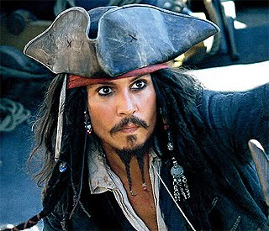
More candidates?

Slide 9
Other Voting Methods
Plurality rule based voting
Plurality method with runoff
Hare rule
Comb rule
Negative voting
Approval voting
Cumulative voting
If there is a Condorcet winner, choose it. Otherwise, take the Borda Count winner

Slide 10
Which method to adopt?
Number of preferences = N! (N = Number of candidates)
The Borda Count Method - Rank sporting teams or academic institutions.
Borda count does not satisfy the Condorcet winner criterion
As the number of voters increases, the Coombs and Borda methods elect the Condorcet winner with increasing frequency, but the Plurality and Hare methods do so with decreasing frequency.

Slide 11
Bibliography
Stanford encyclopedia of philosophy – Voting Methods
http://www.ctl.ua.edu/math103/voting/4popular.htm
http://theorem.ca/~mvcorks/code/voting_methods.html
http://www.nctm.org/resources/content.aspx?id=7934
http://archives.math.utk.edu/software/msdos/discrete.math/voting/.html

Slide 12
Questions?

Slide 13
Thank You!!! ☺

